Slide 1
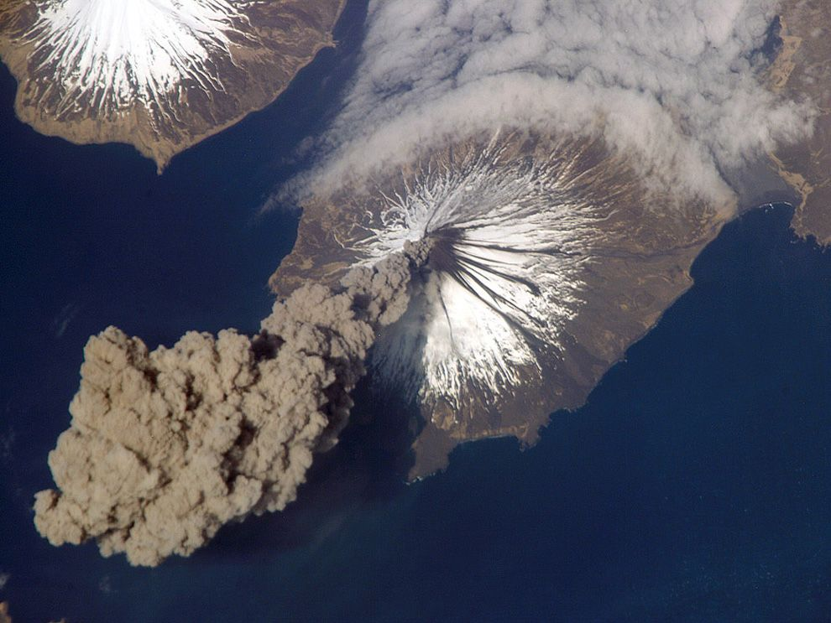
GGIS103 Earth’s Physical Systems
Week 4
Plate tectonics and Volcanoes
NASA Earth Observatory

Slide 2
Objectives
Recall tectonic processes from lecture
Explain how volcanoes are formed
Explain how continental boundaries are related to earthquakes
Describe the Richter Scale

Slide 3
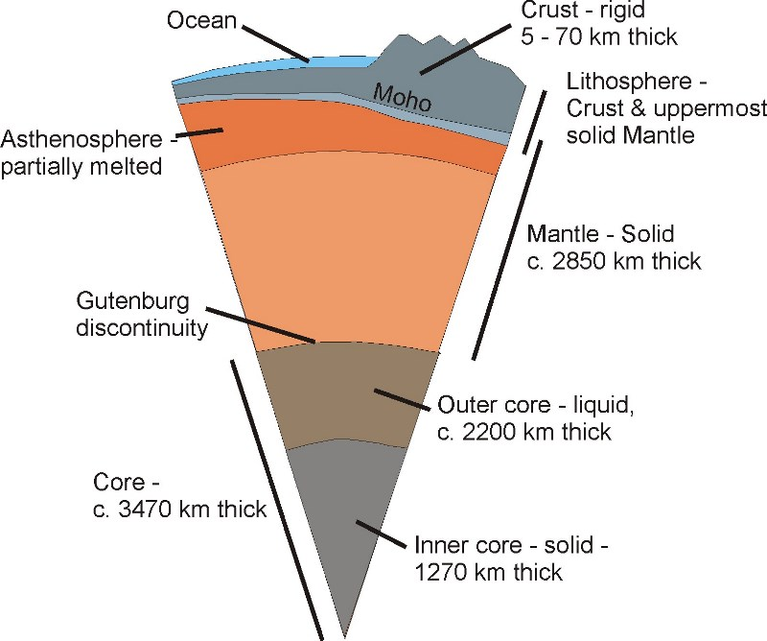
Earth’s Internal Structure
Lithosphere: Rigid top layer consisting of the crust and the very uppermost section of the mantle (the lithosphere is divided into tectonic plates)
Asthenosphere: Viscous layer below the lithosphere that undergoes more plastic deformation (tectonic plates move on top of the asthenosphere)
Notes:
Litosphere is divided into tectonic plates. It covers upper 200km. It’s rigid.
Astenosphere: 200 km to 700km, upper mantle, high temperature, high pressure. Little strength, ductile, plastic. NOT A LIQUID. Plates moves above this. Magma generation.

Slide 4
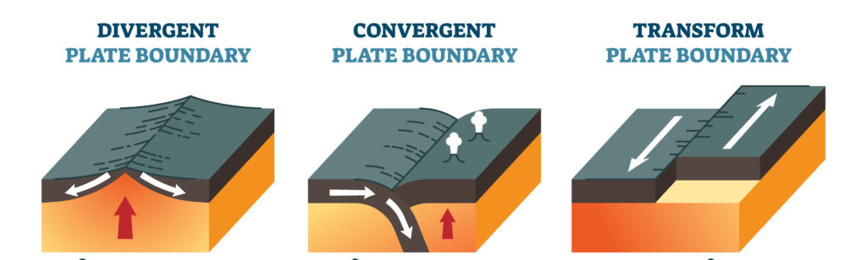
Plate Boundaries
Convergent boundaries – where two plates are colliding.
Divergent boundaries – where two plates are moving apart.
Transform boundaries – where plates slide passed each other.

Slide 5
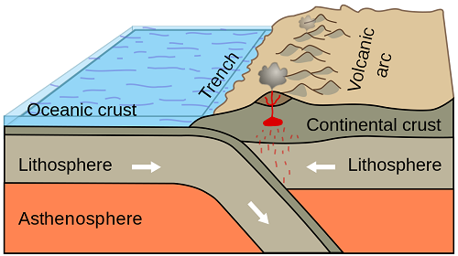
Subduction Zone
Higher density
Notes:
What kind of plate boundary does this diagram show?
One crust is thrust under the other one, usually the denser one

Slide 6
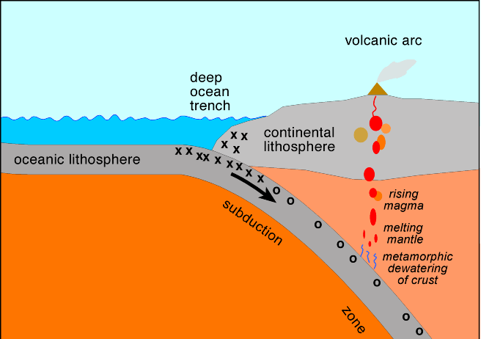
Subduction Zone
Water from subducting plate lowers melting temperature of adjacent mantel rock
Notes:
Why volcanoes occur at subduction zone? Oceanic plate will have water within it and that water will release and help melt the rock and produce magma. And eventually that boyant magma will rise up and form volcanoes.

Slide 7
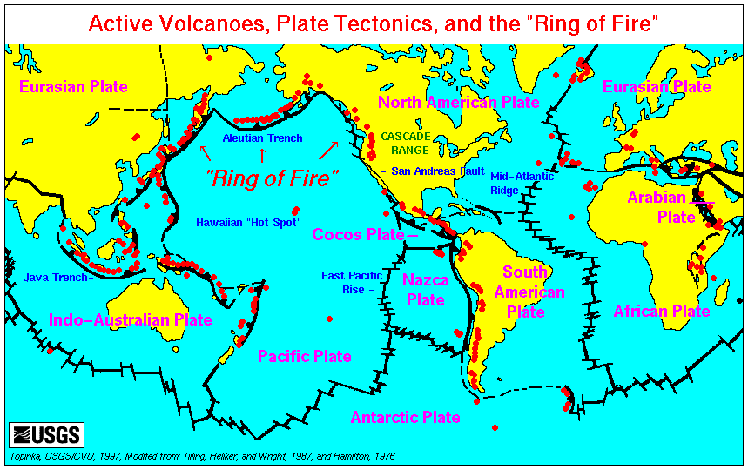
Ring of Fire
Stratovolcano (or composite volcano) — a conical volcano consisting of layers of solid lava flows mixed with layers of other rock.
Notes:
**is a path along the Pacific Ocean characterized by active volcanoes. The majority of Earth’s volcanoes take place along the Ring of Fire.
*Basically, volcanoes only form where there’s a way for the magma to migrate towards the surface – such as a plate discontinuity or an area where the crust is very thin. There are also so-called “hotspots” – areas where the underlying mantle is much hotter than in other areas, heat from this extra hot magma causes thinning of the crust and eventually it breaks and magma rises up and creates the volcano.either due to mantle plumes or lithospheric extension (it’s not clear yet which of the two theories is correct). Examples of hotspots include Hawaii and the Portuguese island of Madeira, but for the most part, volcanoes lie at the edge of tectonic plates.*question-not uniform: ring of fire, boundary of 2 plates

Slide 8
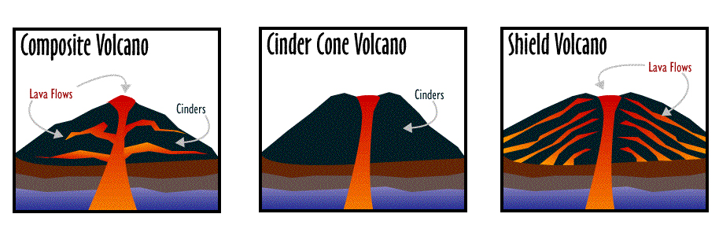
Types of Volcanoes
Cinder cone volcano — doesn’t have any horizontal layers and is instead a steep conical hill of tephra (volcanic debris) that accumulates around and downwind from the vent.
Straight sides (<200m high)
Loose fragment materials, scoria
Notes:
have straight sides and are typically less than 200 m high. Most are made up of fragments of scoria (vesicular rock from basaltic lava) that were expelled from the volcano as gas-rich magma erupted. Because cinder cones are made up almost exclusively of loose fragments, they have very little strength. They can be eroded away easily, and relatively quickly.

Slide 9
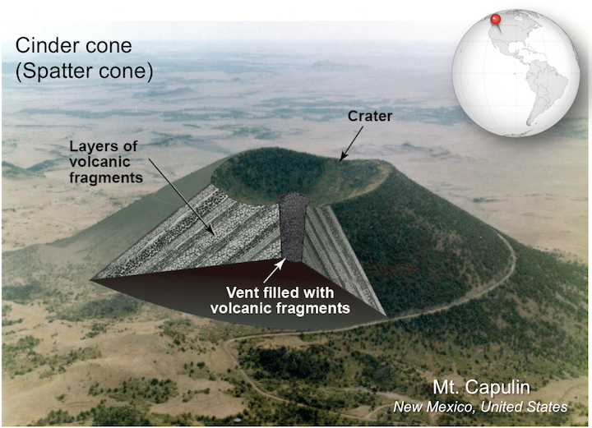
Notes:
Cinder cone. These small, straight-sided volcanoes are made of volcanic fragments ejected when gas-rich basaltic lava erupts. Sources: Karla Panchuk (2017) CC BY 4.0, with photograph by R. D. Miller, U. S. Geological Survey (1980) Public Domain view source. Click the image for more attributions.

Slide 10
Types of Volcanoes
shield volcano — a type of volcano built entirely or mostly from fluid lava vents. They are named like this because when viewed from above, you can see just how massive and imposing they are – like a warrior’s shield.
Low viscosity lava (travel long distance), gentle slope
Notes:
Shield volcanoes, like the Sierra Negra volcano in the Galápagos Islands (Figure 11.23, top), get their gentle hill-like shape because they are built of successive flows of low-viscosity basaltic lava (Figure 11.23, bottom). The low viscosity of the lava means that it can flow for long distances, resulting in the greater size of shield volcanoes compared to composite volcanoes or cinder cones.

Slide 11
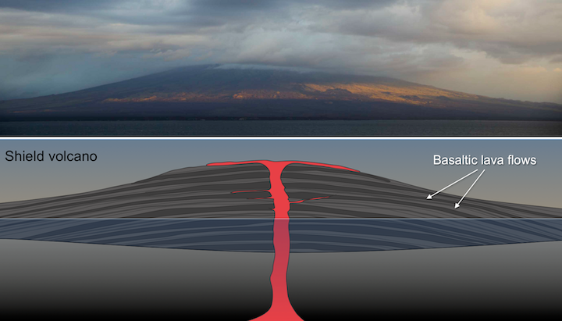
Notes:
Shield volcano. Top: The Sierra Negra volcano in the Galápagos Islands exhibits the low, rounded shape characteristic of shield volcanoes. Bottom: Diagram of a shield volcano island, showing the build up of basaltic lava flows. Sources: Top- BRJ INC. (2012) CC BY-NC-ND 2.0 view source. Bottom- Karla Panchuk (2017) CC BY 4.0

Slide 12
Types of Volcanoes
Stratovolcano (or composite volcano) — a conical volcano consisting of layers of solid lava flows mixed with layers of other rock.

Slide 13
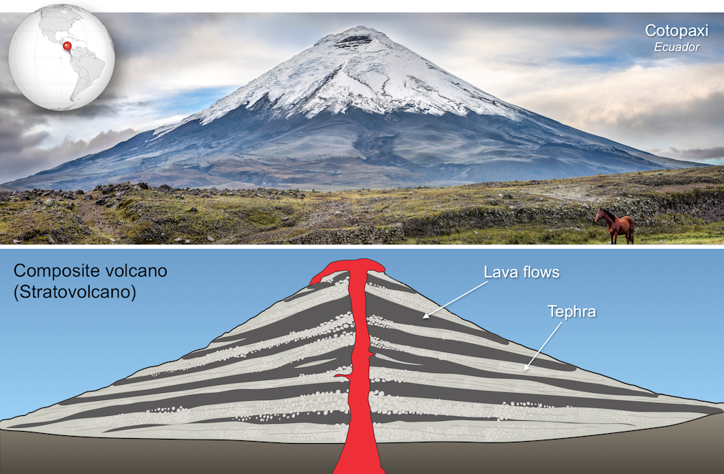
Notes:
Composite volcano. Top: Cotopaxi in Ecuador exhibits the upward-steepening cone characteristic of composite volcanoes. Bottom: Diagram of a composite volcano showing alternating layers of lava and tephra. Sources: Karla Panchuk (2017) CC BY 4.0; Top photo by Simon Matzinger (2014) CC BY 2.0 view source. Click the image for more attributions.

Slide 14
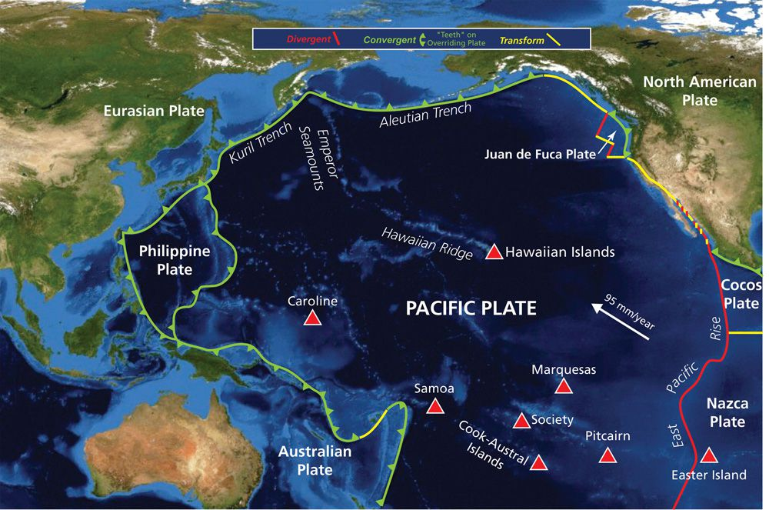
Notes:
Pacific Ocean Hot Spots
The Pacific Ocean is dotted with hot spots. The abrupt right turn taken by the Hawaiian Ridge-Emperor Seamount chain shows how the direction of plate motion changed while the hot spot remained relatively stationary.
Hotspot remain same position independent of overlying

Slide 15
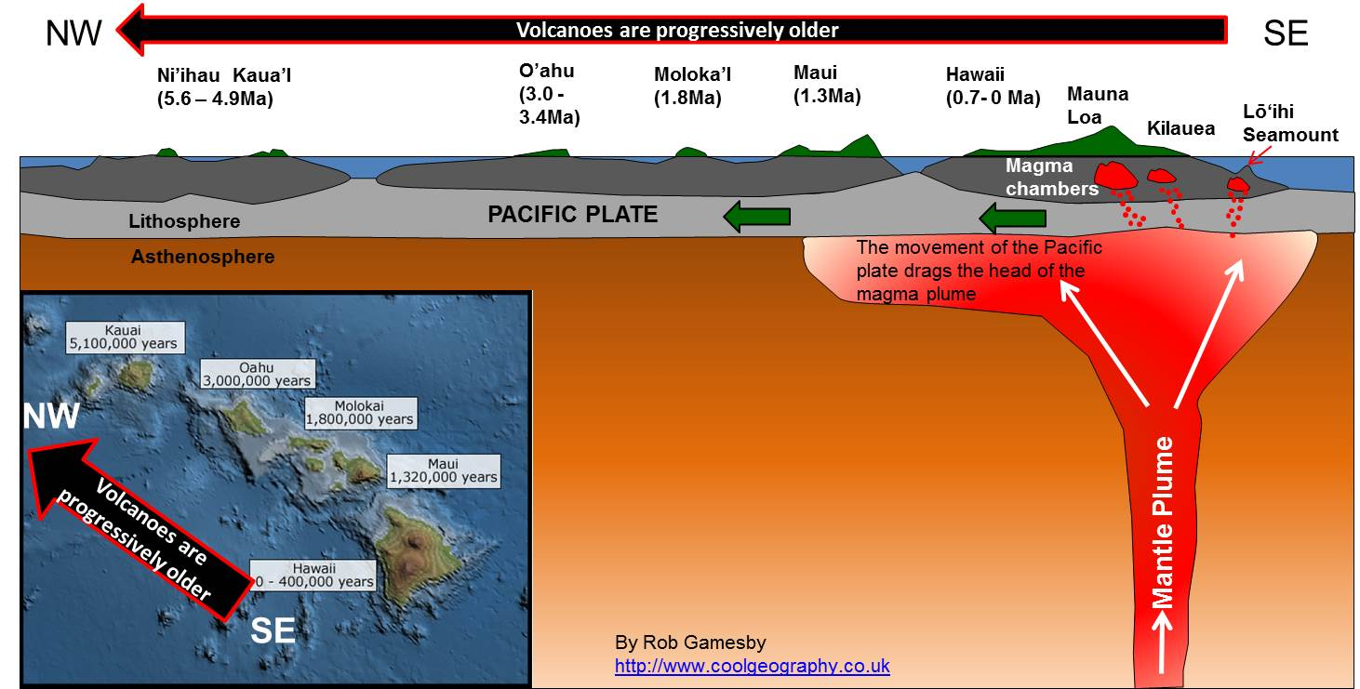
Hot Spots
Notes:
Sleeping Giant
Hot spot volcanism occurs at abnormally hot centers known as mantle plumes. Many geologists depict these plumes of molten rock almost like a lava lamp, features called diapirs. This magmatic diapir sits over the Yellowstone hot spot in Wyoming.

Slide 16
Faults
Fault: Fracture in the lithosphere (continental crust)
Convergent boundaries – Reverse fault
Divergent boundaries – Normal fault
Transform boundaries – Strike-Slip fault

Slide 17
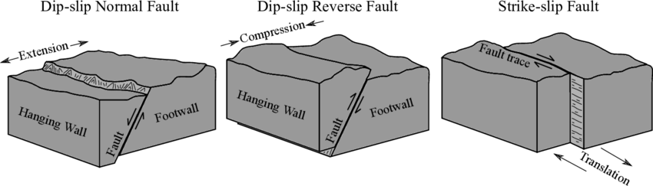
Faults

Slide 18
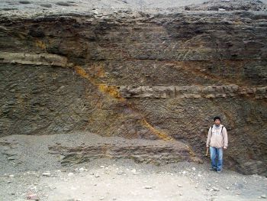
Notes:
Normal Fault

Slide 19
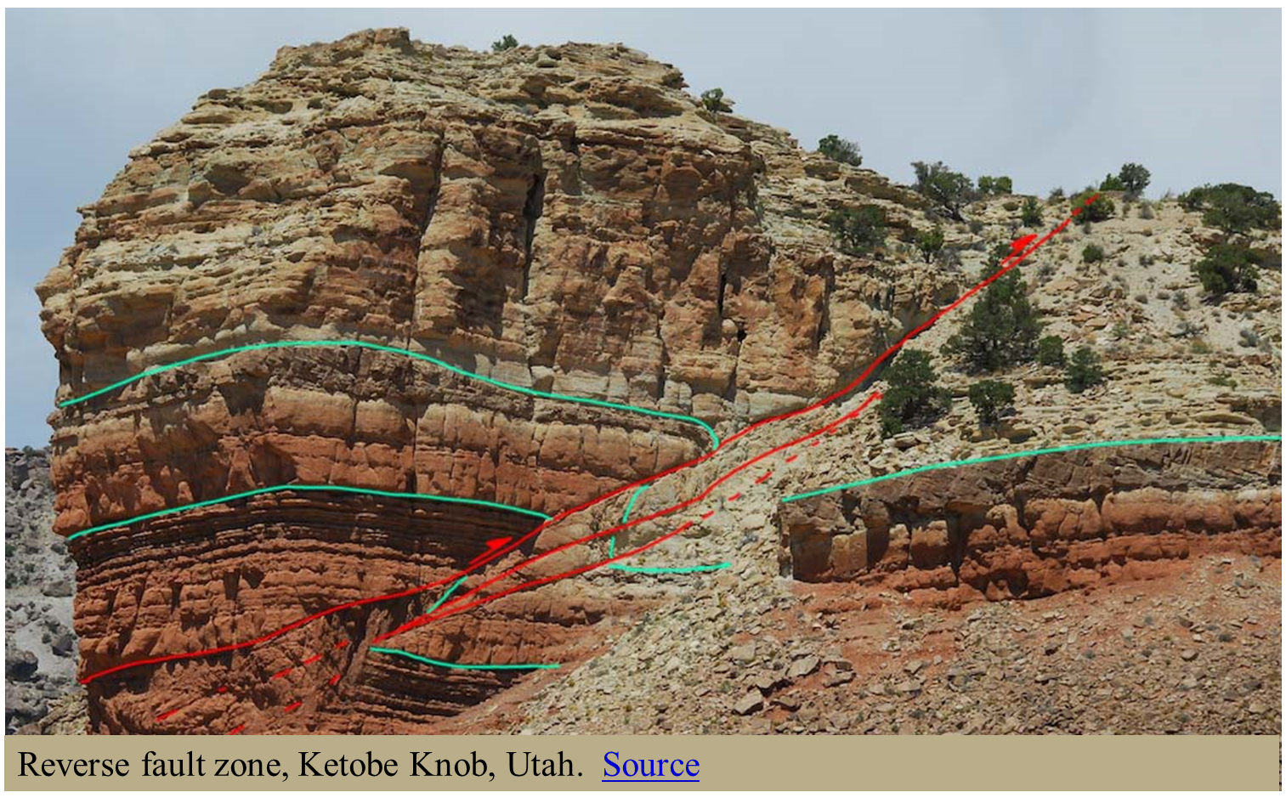
Notes:
Utah- Reverse Fault

Slide 20
Earthquakes
Faulting = Earthquakes
Earthquakes are measured by their magnitude and intensity
Magnitude
Measures the energy released at the source of the earthquake
Measured from seismographs and quantified on the Richter Scale
Intensity
Measures the strength of shaking produced by the earthquake at a certain location
Determined by its effect on people, human structures, and the natural environment.

Slide 21
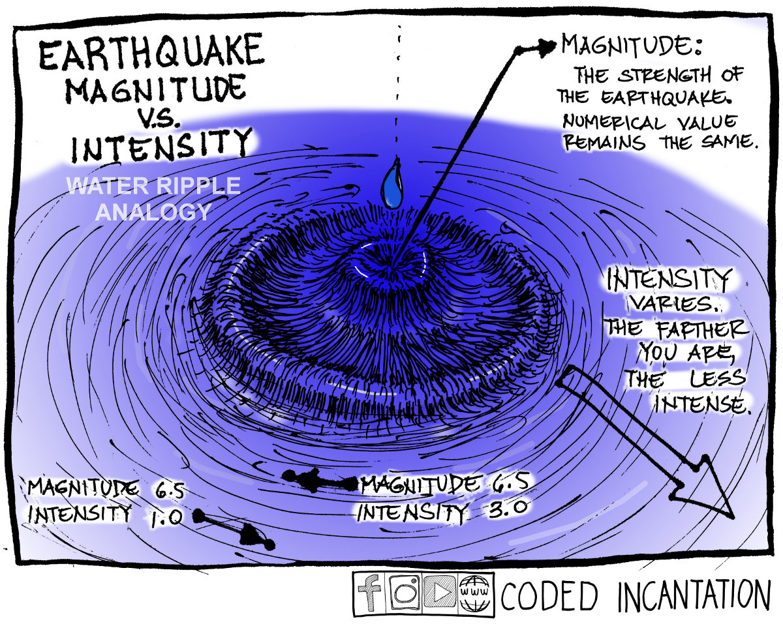
Notes:
Coded Incatation

Slide 22
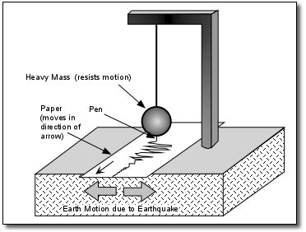
Seismograph

Slide 23
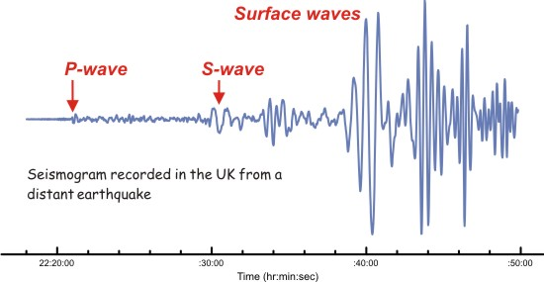
Seismograph
(primary)
(secondary)

Slide 24
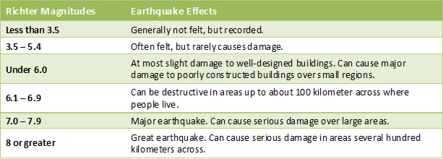
The Richter Scale
The Richter scale was invented by Charles F. Richter in 1934, in order to measure an earthquake's magnitude ( force ), calculated form the amplitude of the strongest seismic wave recorded for a specific earthquake.
The Richter scale is calculated by measuring the time between the Primary ( P ) and Secondary ( S ) waves of the earthquake - also giving us an approximate distance to the focus of the quake.

Slide 25
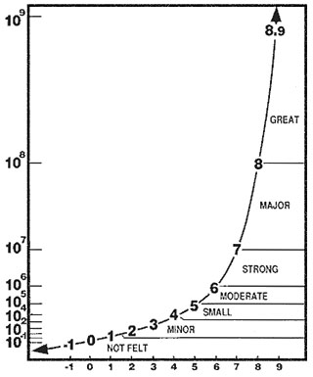
The Richter Scale
Base-10 Logarithmic Scale
Each order of magnitude is 10 times more amplified than the last one
Wave amplitude
Richter 2 is 10 times greater in amplitude than Richter 1
Richter 3 is 100 times greater than Richter 1
Notes:
Each magnitude increases by a factor of 10

